Slide 1
Real-time Ocean Rendering
Anda Li, Yehua Lyu

Slide 2
Content
Wave Spectrum Generation
BRDF Lighting
Sun light
Sky light
Water color
Ocean White Caps
Performance Analysis

Slide 3
Wave spectrum
Create spectrum each frame using equations from the paper
Perform inverse fourier transform
Store results in Rendertextures

Slide 4
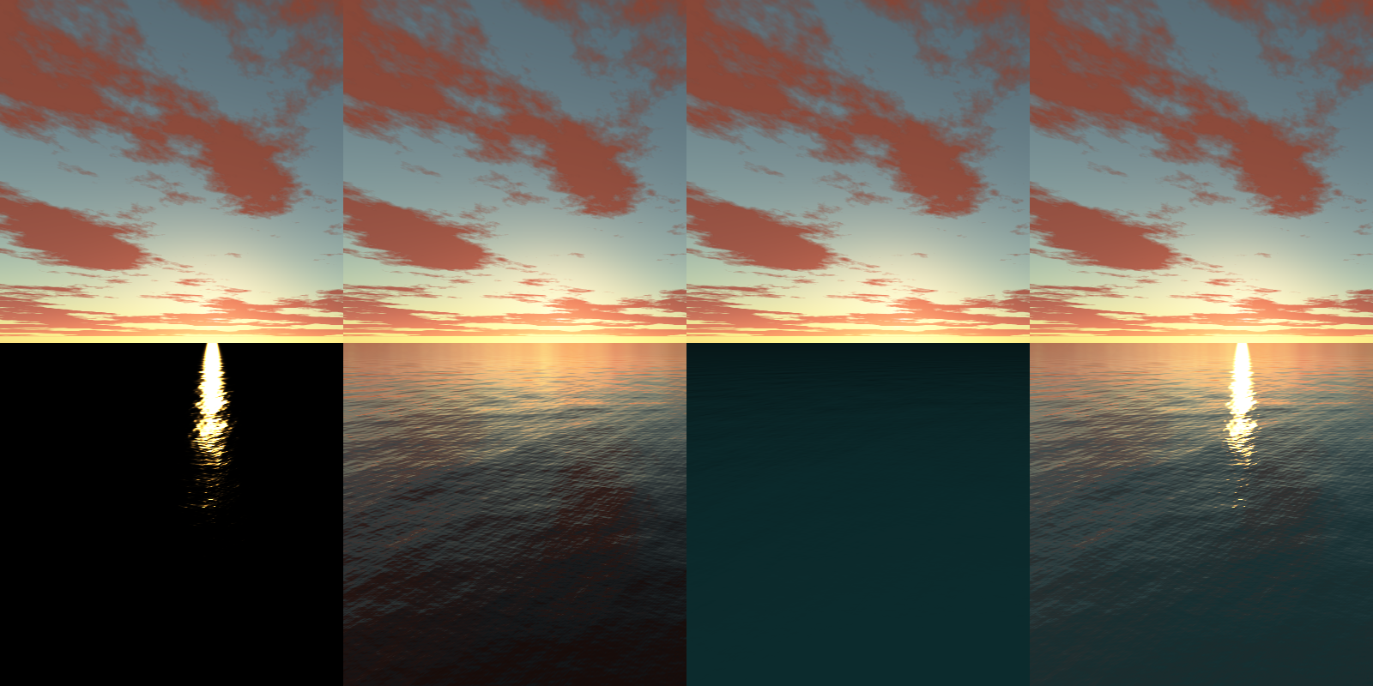
BRDF Lighting
Refracted light
Reflected sun light
Reflected sky light

Slide 5
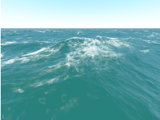
Ocean White Caps
Choppiness
Jacobian determinant
Displacement on X and Z

Slide 6
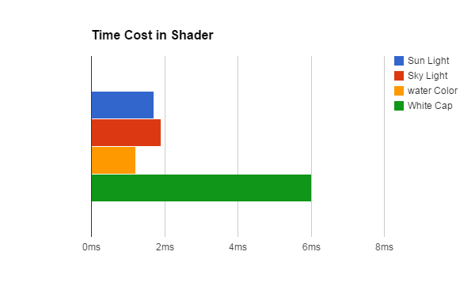
Performance Analysis

Slide 7
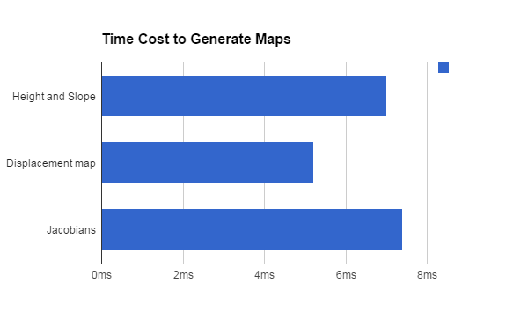
Performance Analysis

Slide 8
References
“A unified directional spectrum for long and short wind-driven waves” - T. Elfouhaily, B. Chapron, and K. Katsaros
Eric Bruneton, Fabrice Neyret, and Nicolas Holzschuch, (2010) Real-time Realistic Ocean Lighting
Real-time Animation and Rendering of Ocean Whitecaps. Jonathan Dupuy ∗. Eric Bruneton †. INRIA Grenoble Rhône-Alpes

